Slide 1





HackOrbit 2025
Team name: Central Syntax
QueryWise

Slide 2


THEME & PROBLEM STATEMENT
Theme:
Open Innovation
Problem:
Database Management is powerful but hard to learn and apply without real-time feedback, schema visibility, or intelligent help.
Challenges:
Hard to learn SQL without live feedback
Students memorize but can’t apply queries
Developers struggle with schema visibility
Query debugging is time-consuming
No unified tool with AI + DB interaction

Slide 3

PROPOSED SOLUTION
Import MySQL and MongoDB databases (local or cloud-hosted)
Display real-time database schema
User data encryption by ECC Method
Translate queries: English ⇄ SQL
AI chatbot for DBMS help (plug & play)
Run live SQL queries & show instant output
Voice input to speak natural queries and auto-convert to SQL
Research Paper :- QueryWise Research Paper

Slide 4
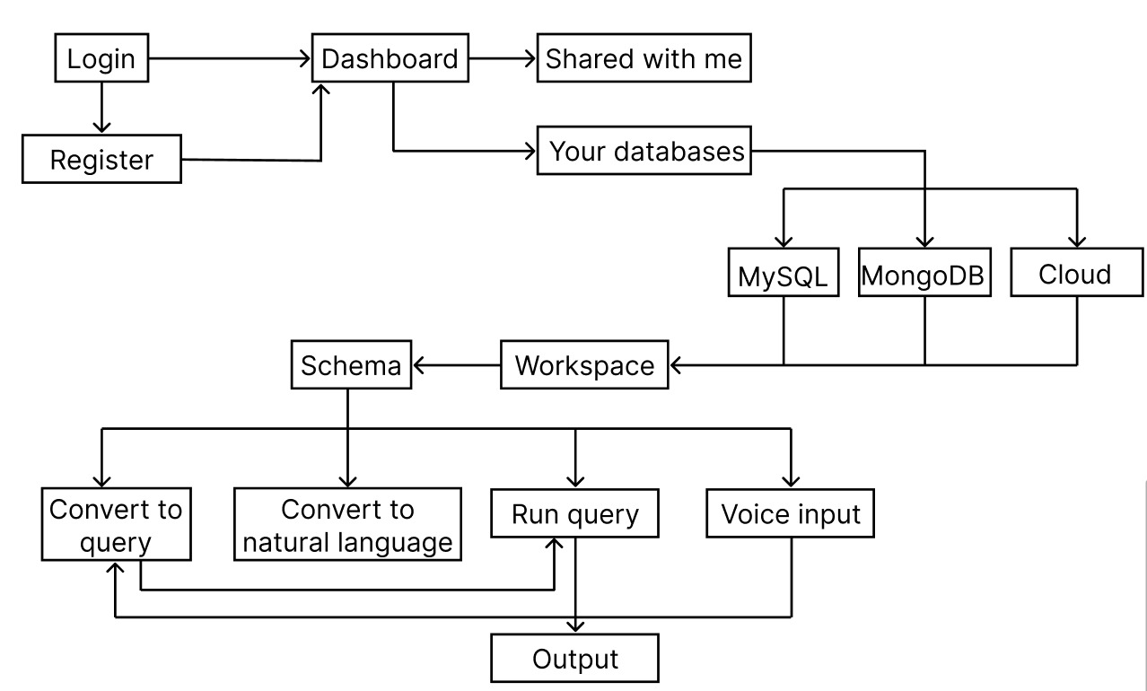
FLOWCHART

Slide 5
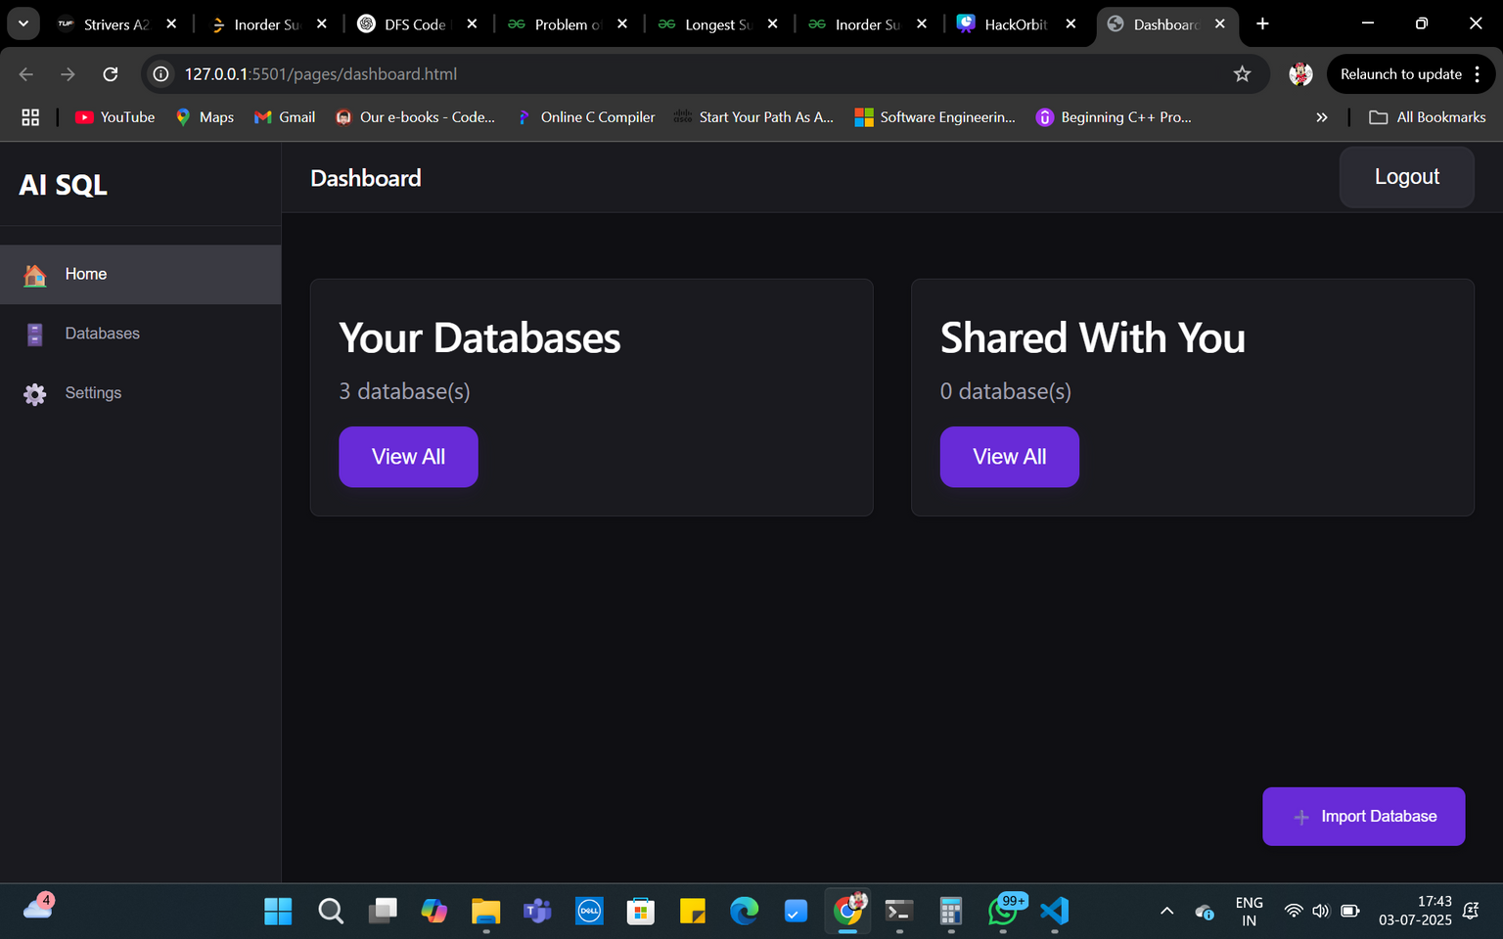
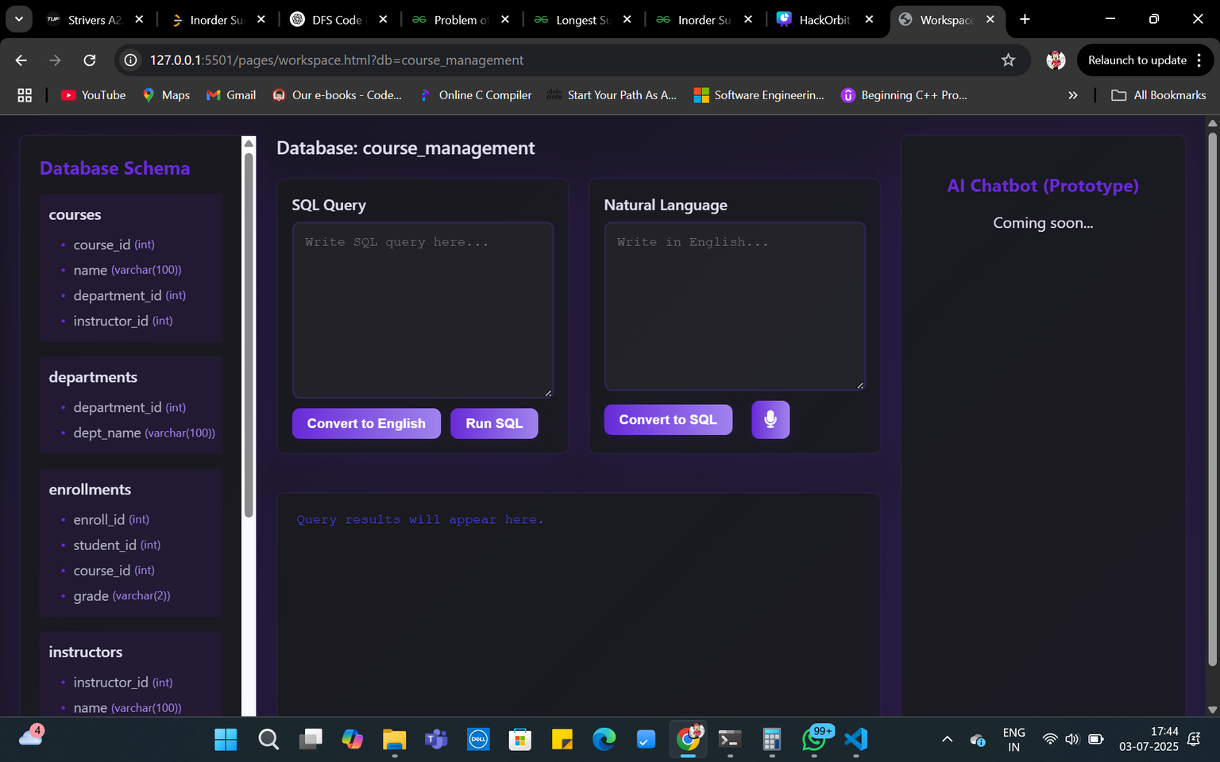
DEMONSTRATION VIDEO
Video Demo :-
Prototype to explain the flow of Query Wise(AI SQL Assistant)

Slide 6


FEATURES AND NOVELTY
Features
Novelty
Login/Register System
Database Dashboard
Schema Visualization
English ↔ Query Conversion
Run Live Queries
AI Chatbot Assistant
Voice Input Support
Model-Based Intelligence
All-in-One SQL Assistant
Learning + Professional Use
Schema-Aware AI
ECC-Based Secure Login
Hands-Free Querying
AI-Driven Explanation Engine
Fully Modular & Scalable

Slide 7
DRAWBACK AND SHOWSTOPPERS
Drawbacks:
- Limited accuracy for complex natural language queries
- No undo/rollback for executed SQL operations
Key Showstoppers:
- Incorrect query execution may affect database integrity
- Cloud database import may fail due to misconfiguration
USP’s:
- Dashboard + Real-World Database Import
- All-in-One Tool: Learn, Practice, Execute and Teach

Slide 8
Central Syntax
Rakshita Ganjewar (rakshitaganjewar@gmail.com)
Rutuja Kale (rutuja.s.kale@cumminscollege.in)
Rahi Padwal (padwalrahi@gmail.com)
Sejal Saraf (sejalsaraf19@gmail.com)

Slide 9
Thank you

